Slide 1
Student Registration/ Personal Needs Profile
Notes:
Welcome to the Student Registration/Personal Needs Profile training module.
This training module gives an overview of the steps for registering students in order to receive RICAS test materials for both computer-based testing (CBT) and paper-based testing (PBT), as well as the steps for indicating selected accessibility features and accommodations.
It is recommended that this module is watched in conjunction with the Guide to the SR/PNP which can be found on the RICAS Resource Site at ricas.pearsonsupport.com/manuals.

Slide 2
Topics
Glossary of Terms Used in this Training Module
Overview of the SR/PNP Process
Determining a method for updating the SR/PNP
Updating SR/PNP by File Export and Import
Updating SR/PNP in PearsonAccess^{next} User Interface
Resources
Notes:
In this training module, we will cover the topics listed on this slide.
By the end of this module, you’ll become familiar with the process for ordering materials. The last slide of this module will show you additional resources that are available to help you complete the process on your own.

Slide 3
Glossary
PearsonAccess^{next} (PAN): the online test management system. All schools will use PAN to review student test settings for each content area, including assigning accommodations and accessibility features, and manage testing activities for computer-based testing.
Student Registration (SR): student information needed to register a student for a test
Personal Needs Profile (PNP): the collection of accessibility features and accommodations a student needs to take a test
SR/PNP File: a file containing your student data to be imported to PearsonAccess^{next}
Guide to the SR/PNP Process: the guide posted at http://ricas.pearsonsupport.com/manuals defines the field names and expected values for the SR/PNP file
Notes:
Please take a moment to pause the module so that you can read the definitions of the different components of the SR/PNP process. The pause button is located on the bottom, left-hand side of the screen.

Slide 4
Overview of the SR/PNP Process
RIDE begins the nightly feed that uploads and registers grades 3-8 ELA and Math student records into PearsonAccess^{next}
School personnel ensure that the student data transferred to RIDE from their district SIS through the enrollment census, LEP census, and special education census remain complete and accurate.
School personnel review student records in PAN and add accommodations and accessibility features for students, as necessary.
Notes:
Here are the steps for the SR/PNP process for the RICAS Grades 3-8 ELA and Math administration.
Step 1. RIDE begins the nightly feed that uploads and registers grades 3-8 ELA and Math student records into PearsonAccess^{next}
Step 2. School personnel ensure the student data transferred to RIDE from their district SIS through the enrollment census, LEP census, and special education census remain complete and accurate.
Step 3. School personnel review student records in PAN and add accommodations and accessibility features for students, as necessary.
You can find more information on the process, including dates, in the Guide to the SR/PNP found at ricas.pearsonsupport.com/manuals starting on page i.

Slide 5
Determining a method to update the SR/PNP
Option 1: SR/PNP Export and Import:
Best option if a large number of updates to student accommodations and/or accessibility features need to be made
School personnel may want to use this method to place students into computer-based test sessions using the SR/PNP file once all accommodations and/or accessibility features have been updated
Option 2: PearsonAccess^{next} User Interface:
Best option if there are only a small number of student records that need to be updated with accommodations and/or accessibility features (i.e., fewer than about 5)
Notes:
SR/PNP Export and Import:
You may want to export all students from PearsonAccess^{next} into an Excel file so the students can be filtered by name, grade, accommodations, etc. By using the Guide to the Student Registration / Personal Needs Profile, you can verify that you have the correct expected values in any given column. This is another way to place students into computer-based test sessions prior to importing the file to PearsonAccess^{next}. For information about creating sessions or managing students in sessions, please review the applicable module posted on the RICAS Resource Center's Training Modules page.
PearsonAccess^{next} User Interface:
If you know you will only need to make a few updates or if you need to add only a handful of students, you can do this in the PearsonAccess^{next} User Interface.
All the steps that we will go over in the next few slides are also explained with screen shots in the Guide to the SR/PNP starting on page 1.

Slide 6
Updating SR/PNP by File Export and Import
Notes:
First you will need to export the file from PearsonAccess^{next}. This will give you the most current list of registered students regardless of when the students were added. The exported file will be in the same format needed to import (.csv).
When you import the SR/PNP file, it will update the accommodations, accessibility features, and sessions (if used) fields for student records that were modified in the file, and ignore any fields that were not changed. Student demographic information cannot be updated through this import – changes must be made through the district SIS and transferred to RIDE through the district’s regular process. If student demographic information is changed, that record will error out and not be updated in PAN.
Please note: PAN Session assignments can only be loaded this way ONCE; after that initial load, any session assignment edits can only be made manually through that interface.
See the Sessions Management module at ricas.pearsonsupport.com/training/ for more information.
Go to Setup and Import / Export Data.

Slide 7
Updating SR/PNP by File Export and Import
Click Select Tasks.
In the tasks list dropdown, select Import / Export Data.
Notes:
Click Select Tasks > Import / Export Data.

Slide 8
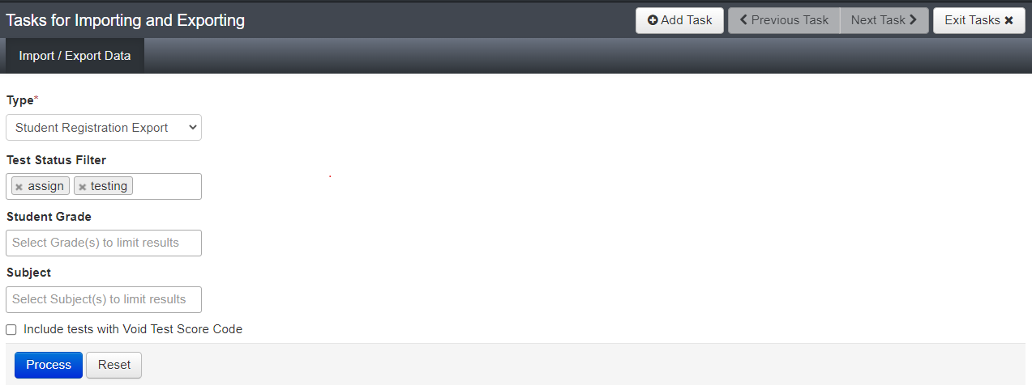
Updating SR/PNP by File Export and Import
In the Type dropdown, select Student Registration Export.
Leave the Test Status Filter as-is and ignore the “Include tests with Void Test Score Code” checkbox.
Leave Student Grade and Subject boxes unselected to export all students.
Click Process.
Notes:
In the Type dropdown, select Student Registration Export. Leave the Test Status Filter as-is and ignore the “Include tests with Void Test Score Code” checkbox. Leave Student Grade and Subject boxes unselected to export all students. Click Process.

Slide 9
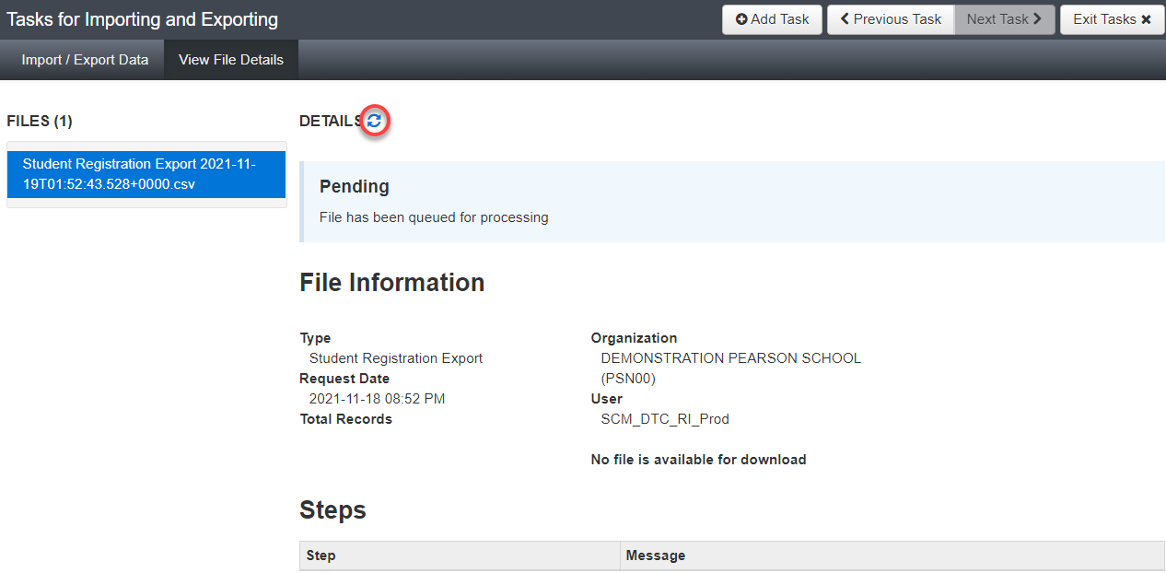
Updating SR/PNP by File Export and Import
Refresh the page by clicking on the highlighted circular arrows.
When done, the following green message will appear: “Complete – File is Ready for Download” (see next slide).
Notes:
Refresh the Page by clicking on the highlighted circular arrows.
When done, the following green message will appear: “Complete – File is Ready for Download”. See next slide.

Slide 10
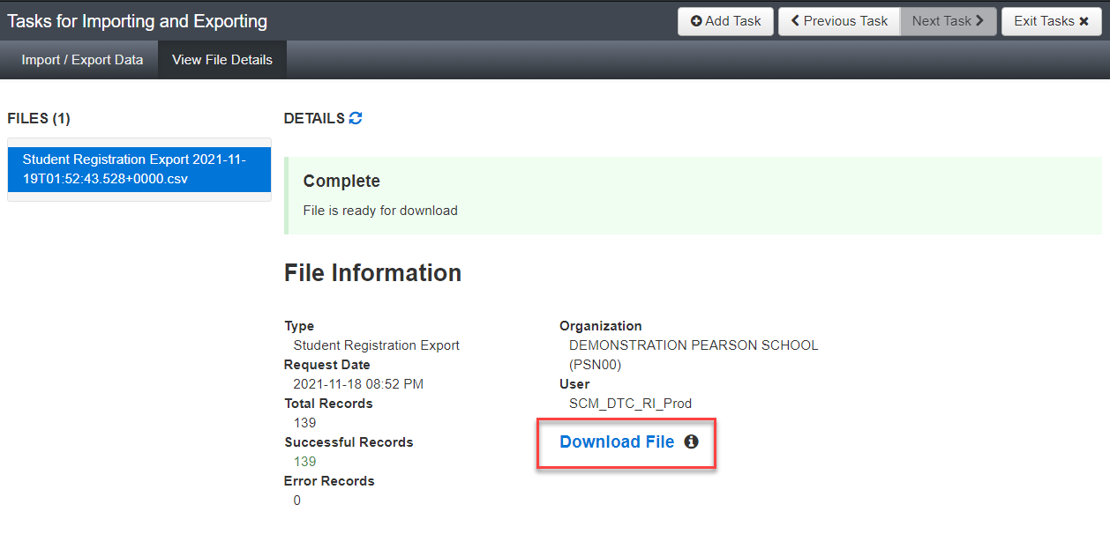
Updating SR/PNP by File Export and Import
Notes:
When the Download File link appears (highlighted in a red box on this screenshot), click it to download. Make any changes you need to the editable fields in the SR/PNP file.

Slide 11
Updating SR/PNP by File Export and Import
1.
2.
Notes:
To import the file again, go to Setup and Import / Export Data. Click Select Tasks > Import / Export Data. In the Type dropdown, select Student Registration Import - RI.
Leave all the options on this page and click Process. Refresh the page until the file has finished importing. Correct any errors, if needed.

Slide 12
Updating SR/PNP in PearsonAccess^{next} User Interface
1.
2.
Notes:
1. To edit SR/PNP information in the User Interface, click Setup and then click Students.
2. You can check all the students’ registration details by clicking the blue info button next to their SASID.

Slide 13
Updating SR/PNP in PearsonAccess^{next} User Interface
Notes:
Or you can check the box next to all or some students, then go to Select Tasks and check Manage Student Tests. That task allows you to also update the accommodations for each student. Make sure you click Exit Tasks when finished to leave the task interface.

Slide 14
Updating SR/PNP in PearsonAccess^{next} User Interface
Notes:
To unregister a student, go to the Register Students task. On this page, uncheck the Registered checkbox. Exit Tasks when finished.

Slide 15
Resources
Guide to the SR/PNP Process | http://ricas.pearsonsupport.com/manuals/
Test administration resources (e.g., manuals, guides) | https://www.ride.ri.gov/Assessment-Manuals
Accommodations and accessibility features manual | https://www.ride.ri.gov/Accommodations
Statewide testing schedule, including SR/PNP deadlines | https://www.ride.ri.gov/Assessment-Schedules
PearsonAccess^{next} User Guide | Import/Export Data Create/Edit a Student Create an Online Test Session
Questions? Contact the RICAS Service Center at ricasservicecenter@cognia.org
or 855-222-8936.
Notes:
Here are resources to help you with this process when you do it yourself.
The Guide to the SR/PNP has all the steps that were explained in this module as well as indicates all the accessibility features and accommodations that are available for the RICAS Grades 3-8 Administration. Please review the Accommodations and Accessibility Features Manual for specific information about determining and assigning accommodations and accessibility features for students.
Refer to the RIDE’s websites for policy information and test administration resources.
The PearsonAccess^{next} User Guide will help with the SR/PNP file import and creating students in the user interface.
For questions about specific accommodations and accessibility features, RIDE accommodations policy, or the student registration process, please contact RIDE's Assessment Office at assessment@ride.ri.gov.
If you have a question about a specific student whose record is in PAN, please only refer to the student by their SASID for confidentiality purposes as email is not a secure form of communication.
If you have questions on ­­­any part of the SR/PNP process, you may contact the RICAS Service Center Hours: 7:00 am-5:00 pm, Monday-Friday Telephone: 855-222-8936 Email: ricasservicecenter@cognia.org Fax: 603-749-5108

Slide 16
Thank you.
Notes:
This concludes the SR/PNP training module. Thank you for taking the time to review this important process.

